Slide 1
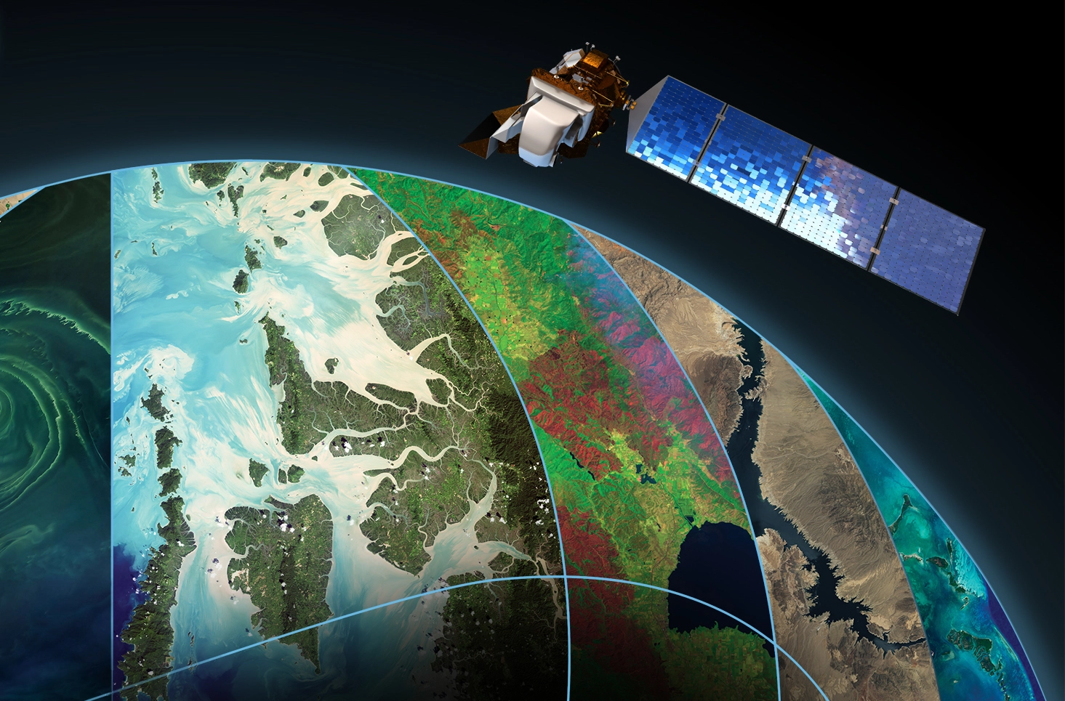
Aerial Scene Multi-class Image Classification
William Simpson
Abou Keita
DATA 690
Practical Deep Learning
Fall 2022
Notes:
Abou

Slide 2
Background
AID is a new large-scale aerial image dataset:
Collected sample images from Google Earth imagery.
Post-processed using RGB renderings from the original optical aerial images, it has proven that there is no significant difference between the Google Earth images with the real optical aerial images even in the pixel-level land use/cover mapping. Thus, the Google Earth images can also be used as aerial images for evaluating scene classification algorithms.
Notes:
Abou

Slide 3
Background
AID is a new large-scale aerial image dataset:
Images in AID are multi-source, as Google Earth images are from different remote imaging sensors.
All the sample images per each class in AID are carefully chosen from different countries and regions around the world, mainly in China, the United States, England, France, Italy, Japan, Germany, etc., and they are extracted at different time and seasons under different imaging conditions, which increases the intra-class diversities of the data.
Notes:
Abou

Slide 4
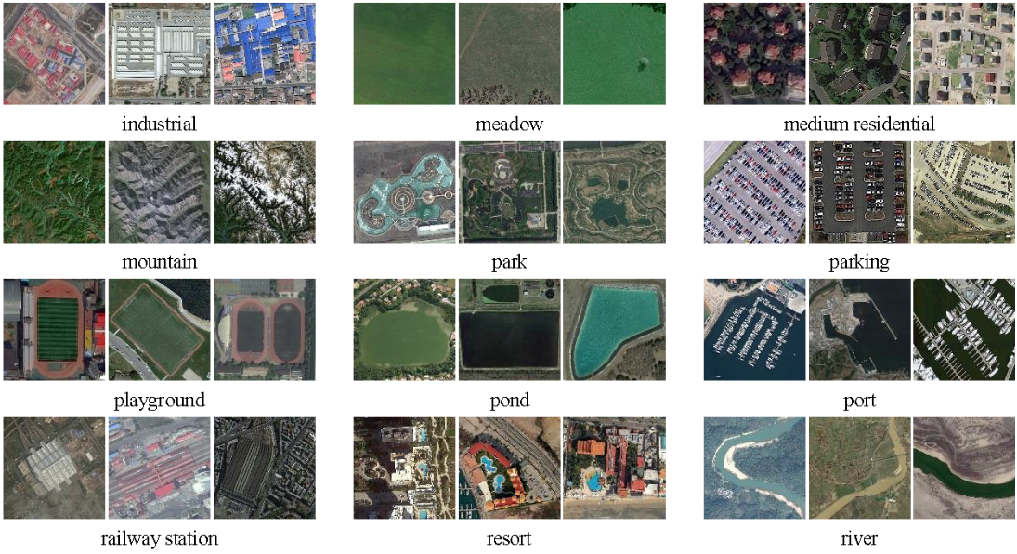
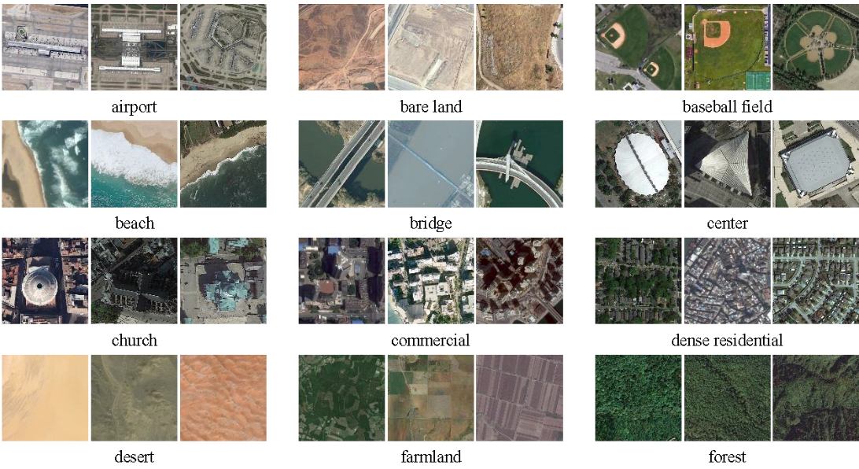
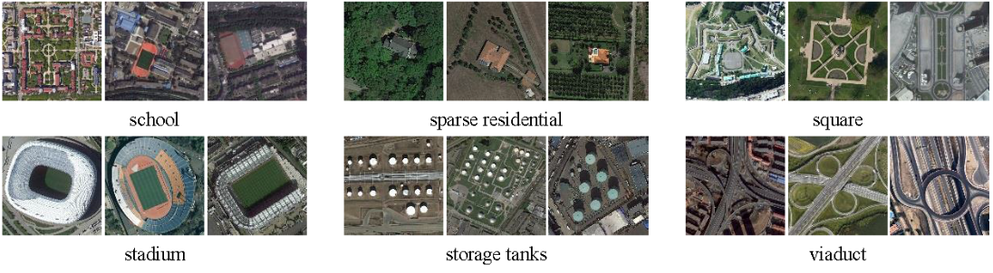
Sample Images from each class
Notes:
Abou

Slide 5
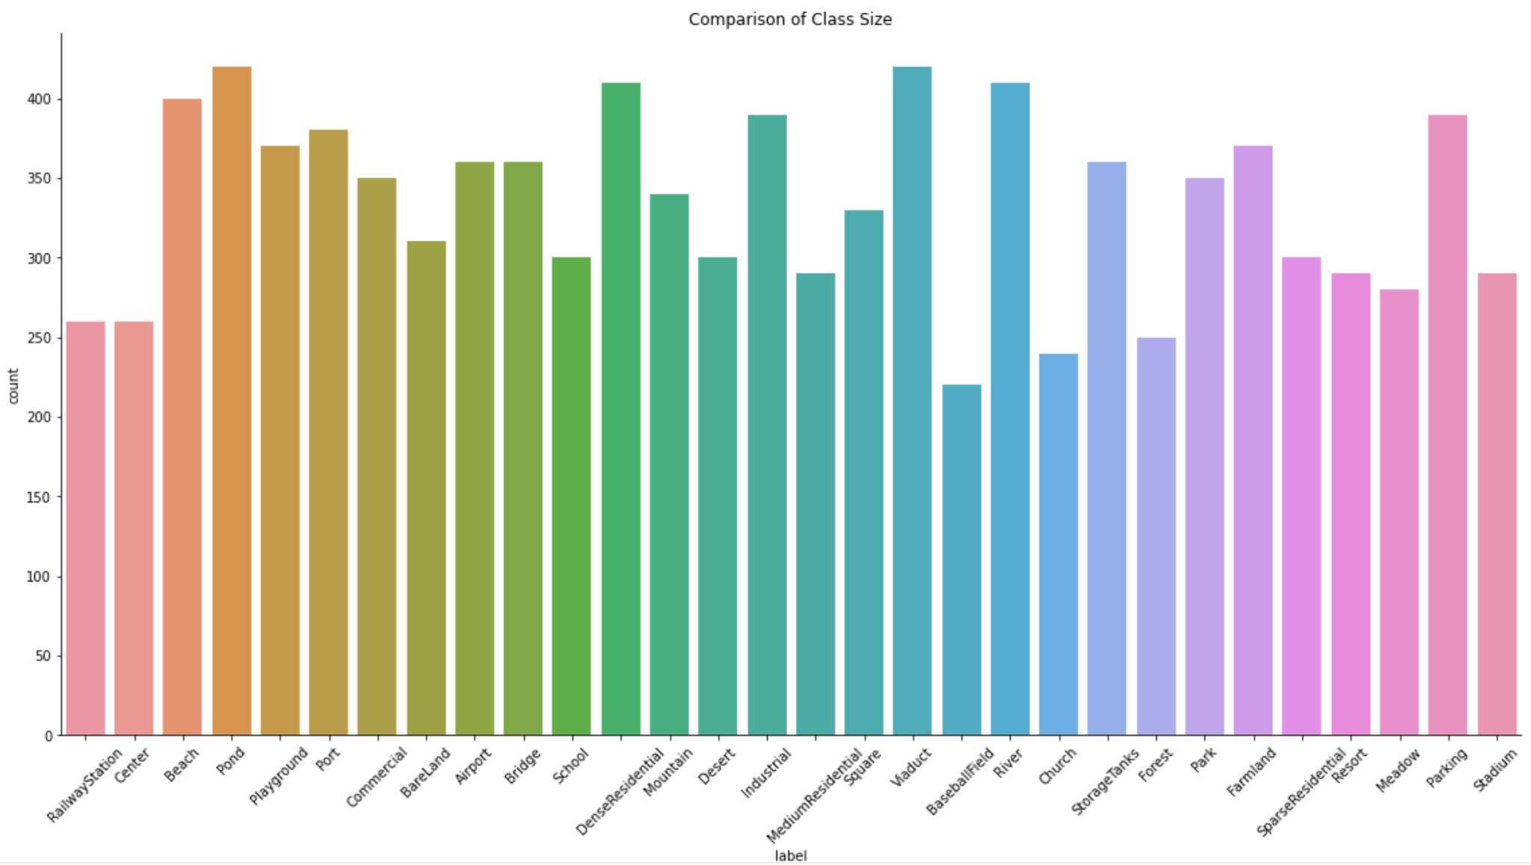
Notes:
Abou

Slide 6
Training Strategy
Transforms:
- Random Horizontal Flip (p=0.4)
- Random Vertical Flip (p=0.4)
- Random Rotation (40 degrees)
- Normalized
Train Set (70%)
Resize to 200x200 pixels
10000 Images
600x600 pixels
30 Classes
Validation Set (15%)
Test Set (30%)
Resize to 200x200 pixels
Transforms:
Normalized
Test Set (15%)
Notes:
Abou

Slide 7
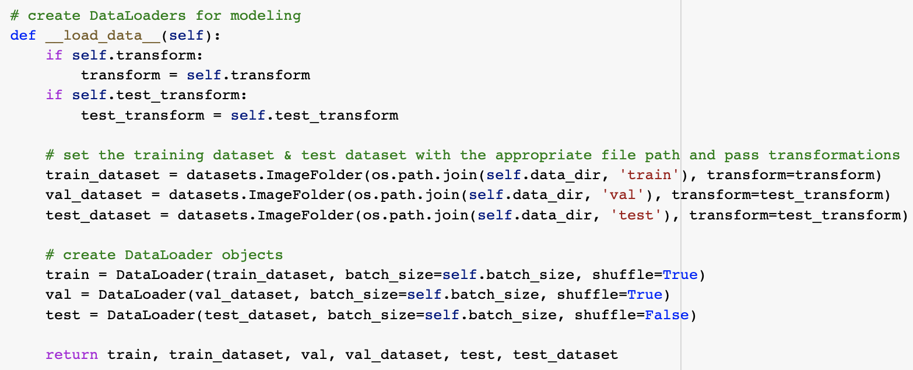
Loading the Data
Notes:
William

Slide 8
Model Architecture
Transfer Learning: Retraining a pre-trained model to perform a new task
Pre-trained Architecture: ResNet50 and VGG16
Learning rate : 0.001
Epochs: 10
Loss function: CrossEntropyLoss (since we are dealing with multiple classes)
Optimizer: Adam
Batch size: 10
Trainable Fully Connected Layers:
FC layer (256 neurons)
ReLu activation function
Dropout (40%)
FC layer (30 neurons = number of classes)
Log Softmax (for multiple classes)
Notes:
William

Slide 9
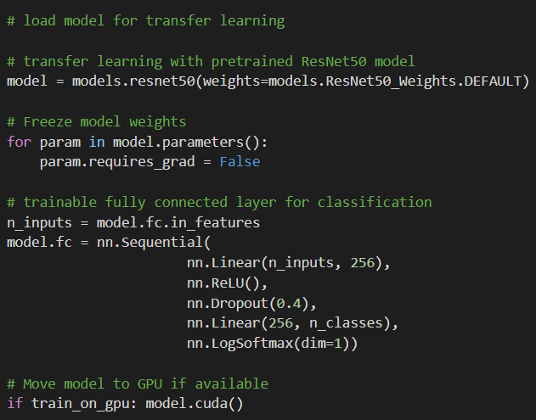
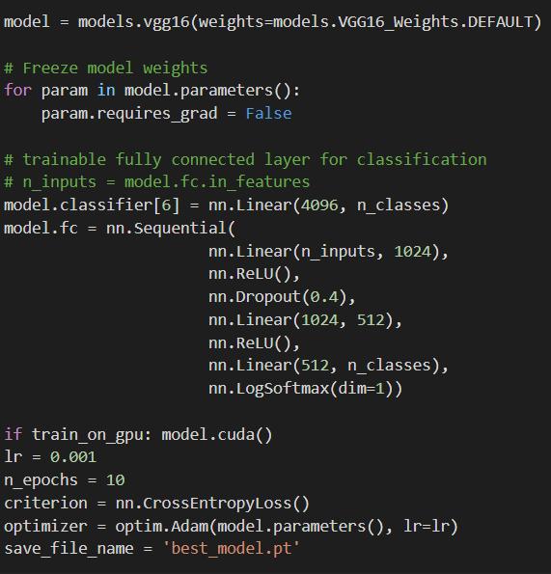
ResNet50 model
VGG16
Notes:
William

Slide 10
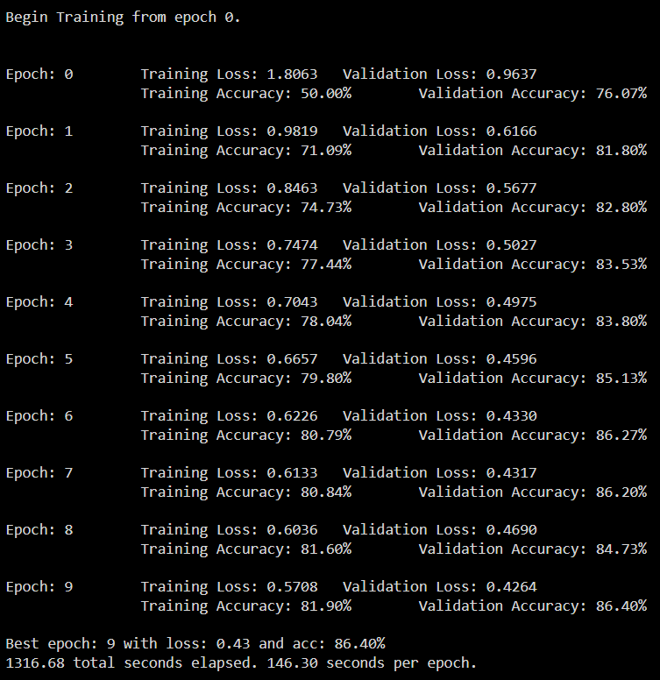
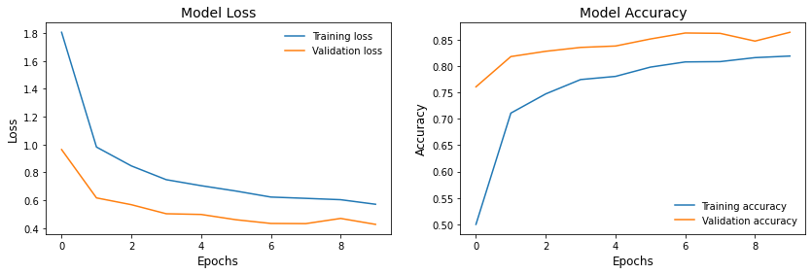
ResNet50 Training
Notes:
Abou

Slide 11
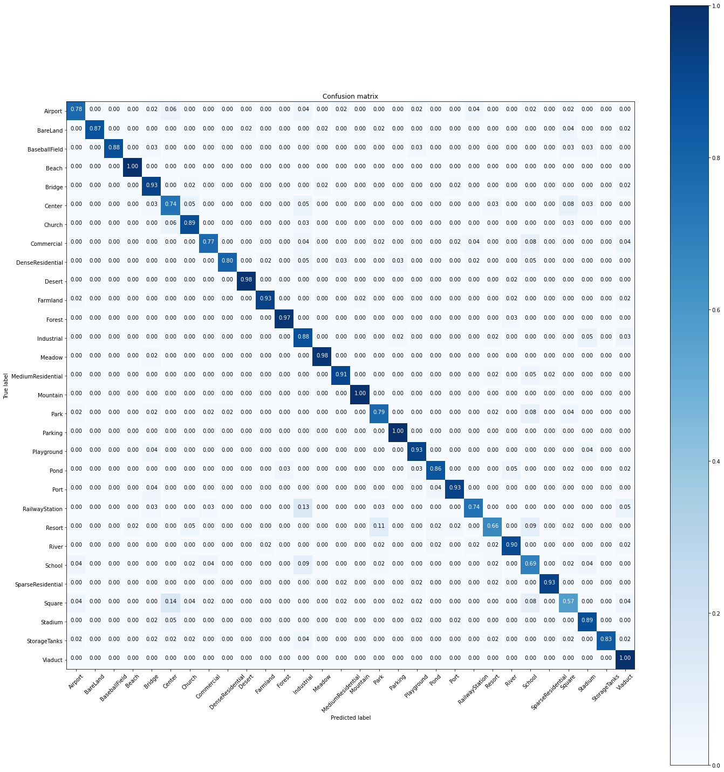
ResNet50 Testing
Overall Test
Accuracy:
87.13%
Notes:
Abou

Slide 12
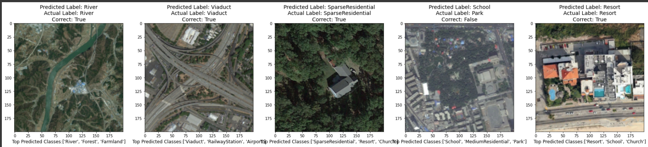
ResNet50 Prediction
Notes:
William

Slide 13
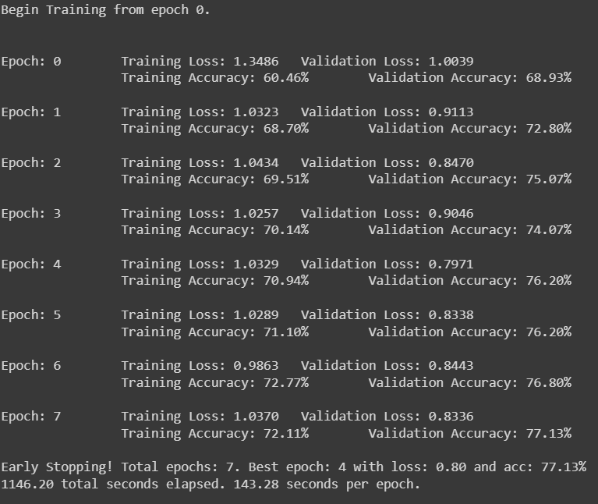
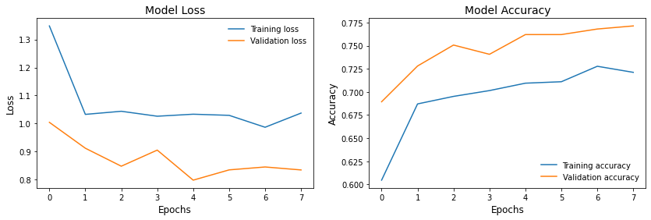
VGG16 Training
Notes:
Abou

Slide 14
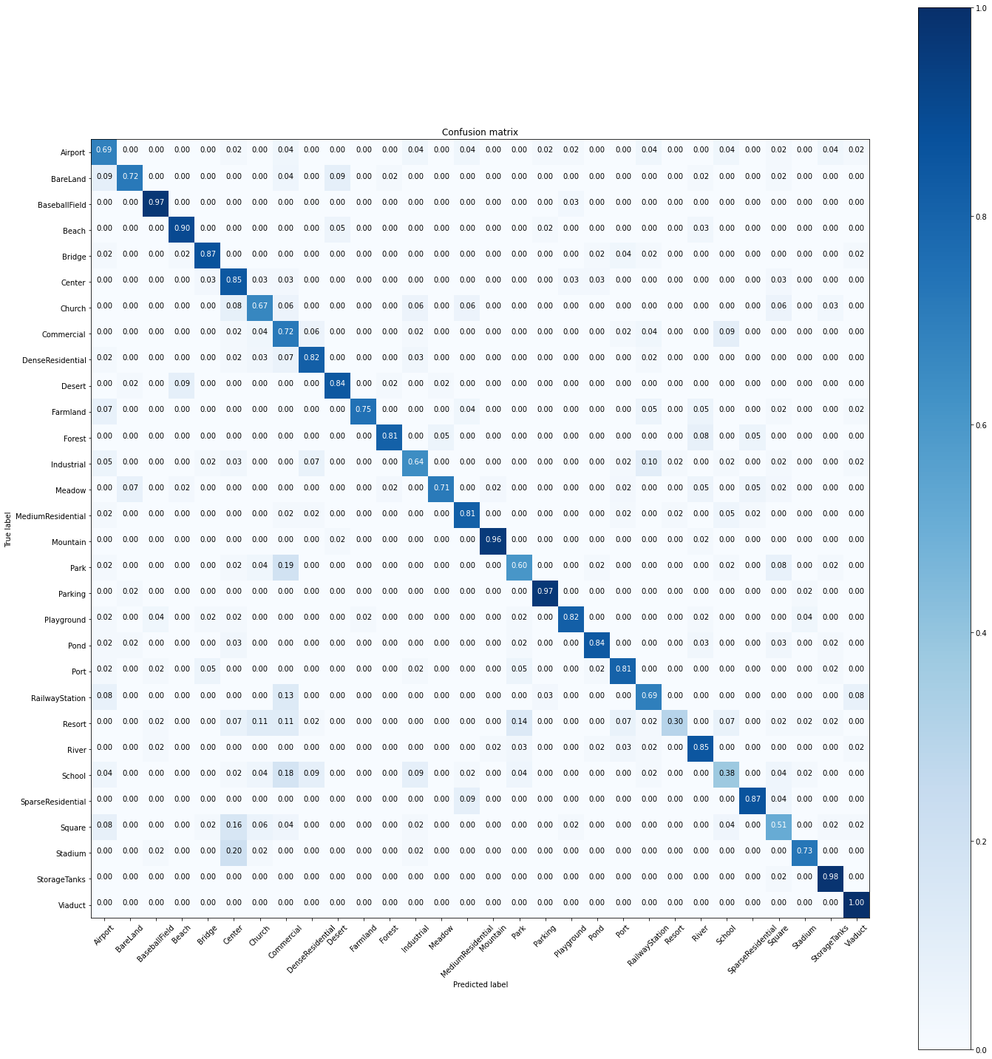
VGG16 Testing
Overall Test Accuracy:
77.6%
Notes:
Abou

Slide 15
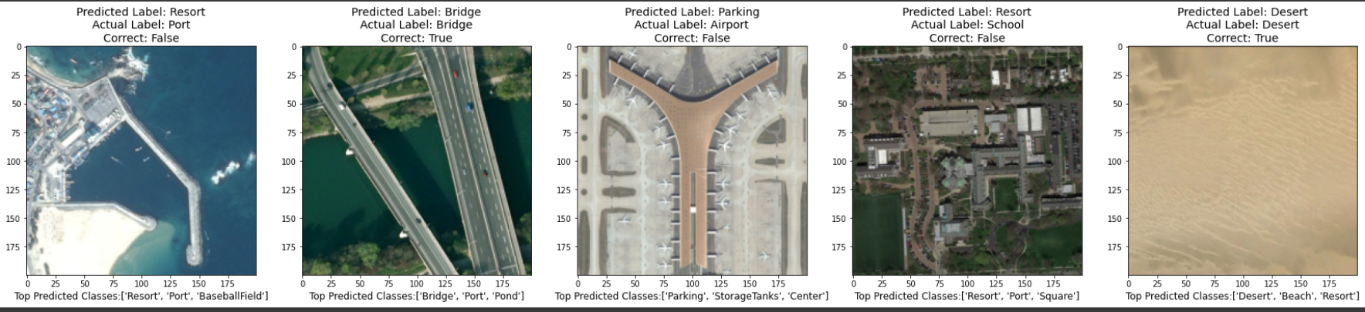
VGG16 Prediction
Notes:
William

Slide 16
Conclusions
Which model performs better?
ResNet50 achieves 87% test accuracy while VGG16 achieves only 77% if trained for the same number of epochs.
Notes:
Abou

Slide 17
Conclusions
Which model performs better?
ResNet50 achieves 87% test accuracy while VGG16 achieves only 77% if trained for the same number of epochs.
What class does the model perform best on?
ResNet50 perform best on Beach, Mountain, Parking and Viaduct classes with 100% accuracy
VGG16 model performs best on Viaduct (100%), Storage Tank (98%), Parking (97%), Mountain(96%), Baseball Field (97%), and Beach (90%) classes
Notes:
Abou

Slide 18
Conclusions
Which model performs better?
ResNet50 achieves 87% test accuracy while VGG16 achieves only 77% if trained for the same number of epochs.
What class does the model perform best on?
ResNet50 perform best on Beach, Mountain, Parking and Viaduct classes with 100% accuracy,
VGG16 model performs best on Viaduct (100%), Storage Tank (98%), Parking (97%), Mountain(96%), Baseball Field (97%), and Beach (90%) classes
What class does it struggle to predict?
ResNet50 struggles with Square, School, Railway Station, and Resort classes that are below 70%.
The VGG16 struggles with Airport, Bareland, Church, Commercial, Farmland, Industrial, Meadow, Park, Railway Station, and Stadium with less than 80 %. The worst performing classes are Resort, School, and Square.
Notes:
Abou

Slide 19
Utility of Deep Learning for Industry
Volume and velocity of the production of satellite imagery
High resolution satellite imagery
Deployment of aerial scene multi-class classification model for real-time inference
Example applications:
GPS mapping technology
Climate impact modeling
Movements of refugee communities and displaced peoples
Reconnaissance and intelligence
Notes:
William

Slide 20
Challenges
Reduction of batch size to avoid out of memory errors
Reduction of large images sizes (600x600 original images to 200x200)
Notes:
William

Slide 21
Challenges
Future Directions
Reduction of batch size to avoid out of memory errors
Reduction of large images sizes (600x600 original images to 200x200)
Balance Classes
Additional hyperparameter tuning and training
Additional exploration of creating a CNN trained from scratch
Notes:
William

Slide 22
Questions?
Notes:
William

